Slide 1
Day 1: Intro To Machine Learning
Mahmoud Abdelmoneum & Nicolas Stone
20 January 2025

Slide 2
Class Objectives
Not a coding class! You may have some prior python knowledge, we want to teach you how to do machine learning (ML) using python skills
Learn the basic principles of ML
Learn how to implement ML in code, especially with the help of tools like ChatGPT
Learn how to learn ML independently → you won’t always have us!
Learn how to identify problems that can be solved with ML, then solve them yourself using ML

Slide 3
Agenda For Today
ML & Course Intro (15 minutes → 1:00pm - 1:15pm)
ML Basics: Model Building Basics (20 minutes → 1:15pm - 1:35pm)
ML Basics: Regression (30 minutes → 1:35pm - 2:05pm)
Break (2:05pm - 2:15pm)
ML Exercise Work Time (90 minutes → 2:15pm - 4:00pm)

Slide 4
Section I: ML Intro

Slide 5

What is Machine Learning?
Try to come up with your own definition of machine learning. Spend 5 minutes discussing with the students around you!

Slide 6
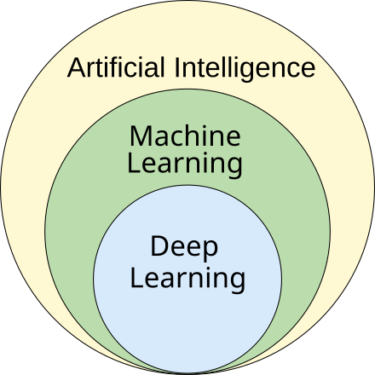
What Is Machine Learning (ML)?
Our Definition: A branch of artificial intelligence that enables algorithms to uncover hidden patterns within datasets, allowing them to make predictions on new, similar data without explicit programming for each task

Slide 7
Why Machine Learning?
Why should we care about machine learning? Spend 5 minutes discussing with the students around you!

Slide 8
Why Machine Learning?
ML is an old field, but recently has grown rapidly due to advances in the hardware that make it possible
Subsequently, ML tools are improving at an unprecedented rate
Because of this, ML has the potential to automate tasks previously only fit for humans, oftentimes doing them even better than humans can

Slide 9
Why Do You Care About Machine Learning?
Why do you care about machine learning? Why are you here? Spend 5 minutes discussing with the students around you!

Slide 10
Why Do You Care About Machine Learning?
ML is an extremely powerful and a rapidly growing field
But in the end, when learning, you need to keep things in perspective
Why are you learning this?
How does it fit into your interests?
How does it fit into your ambitions?

Slide 11
Intro Question 2: From Videos You Watched Over Break, What Are The Kinds of Machine Learning Models? (Hint: 2 Categories)

Slide 12
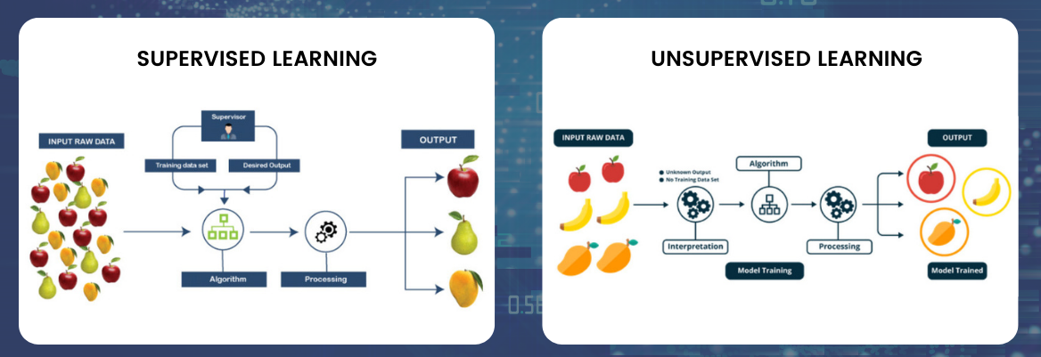
Intro Answer 2: There are Supervised and Unsupervised ML models
Supervised models: pick up patterns from labeled data
Unsupervised models: pick up patterns from unlabeled data

Slide 13
From Videos You Watched Over Break, What Are The Kinds of Problems ML Solves? (Hint: 2 Kinds of Problems)

Slide 14
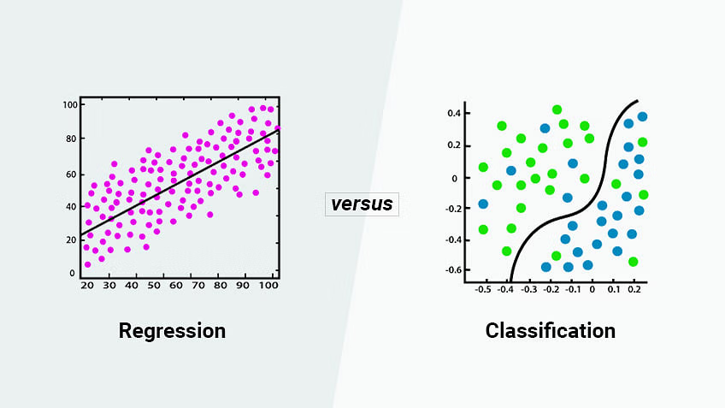
The two main problems that ML solves are Regression and Classification problems
Regression: Predicting a continuous value for a datapoint
Classification: Predicting a discrete categorical label for a datapoint

Slide 15
Section II: Model Building Basics

Slide 16
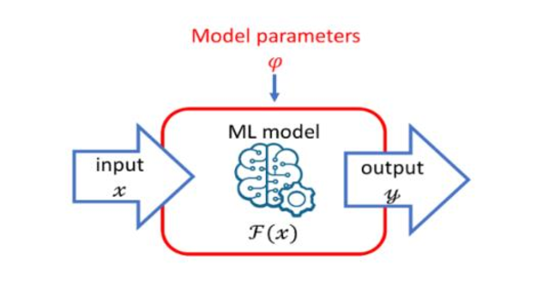
What constitutes a model?
We keep on saying “ML model”, but what actually makes up an ML model?
ML models are made up of parameters, which are modifiable elements that determine what the model outputs
In practice there is a lot of math behind this, but for simplicity we will ignore the math. Simply remember that the output of an ML model is determined by its parameters, which can be changed

Slide 17
How do we build ML models? (Hint: Think about what a model aims to do)
Remember, ML models inherently make some kind of prediction (a value for regression, or a category for classification)
Thus, we can take this prediction and make some kind of evaluation of how “good” this prediction is

Slide 18
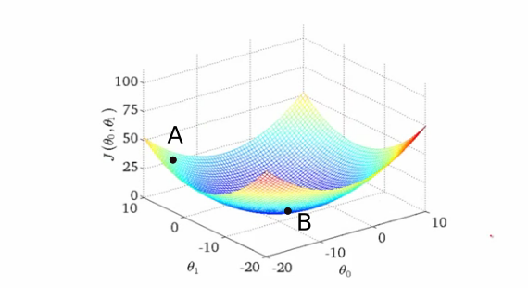
Assessing how “good” a model is: The Objective Function
Objective Function: A tool that we use to determine how “good” a model’s predictions are
This is typically a mathematical function that takes in the model’s prediction, and outputs a number known as a “loss”
Loss tells us how far off our model’s prediction is from what it ideally should be → thus higher loss means a worse prediction, lower loss means a better prediction

Slide 19
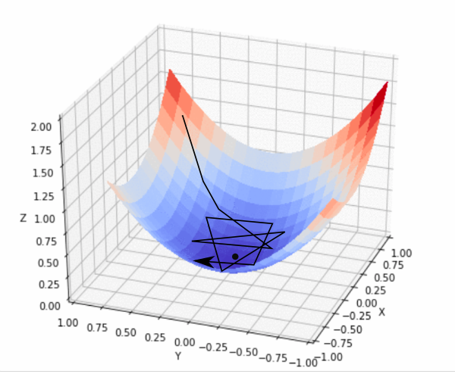
Building Our Model: Training
Training is the process by which an ML model is built
A model is “trained” by finding the parameters that result in the best predictions
Thus we build our model by choosing parameters that minimize our objective function
To do so we use advanced mathematical tools rooted in calculus; The algorithm to train a model (find the optimal parameters) is called Gradient Descent

Slide 20
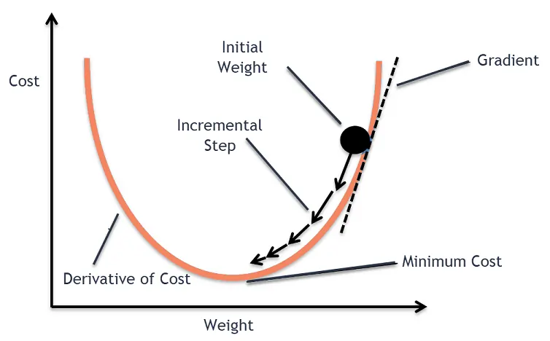
Gradient Descent Explained Simply
Think of the objective function as an equation that has values for all values of the model’s parameters
We want to find the parameter values that minimize the value of the objective function, and gradient descent allows us to do this

Slide 21
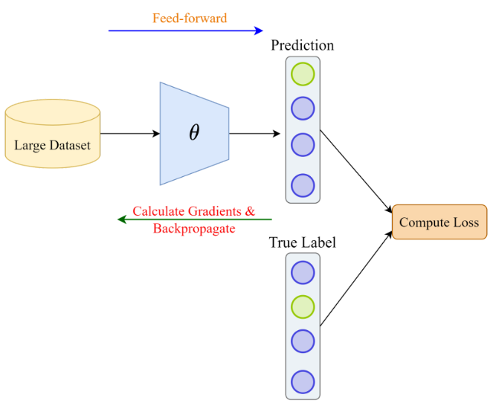
Recap: Elements of An ML Model & How We Build One
An ML model is defined by a set of modifiable parameters which do the mathematical work to generate predictions behind the scenes
To build an ML model, we use a process called training
During training, we select the parameters that minimize the objective function (a measure of how “bad” of predictions the model makes)
To minimize the objective function, we use an algorithm called gradient descent, whereby we search for the parameter values that result in a minimal objective function value

Slide 22
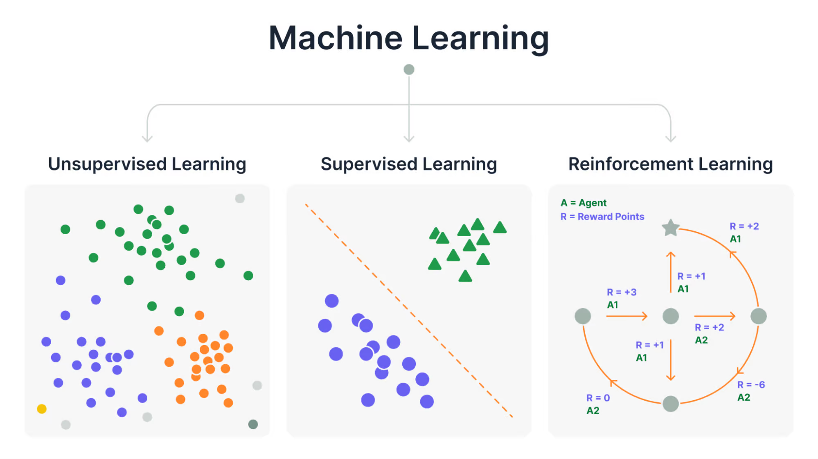
Note: This generalized process to build an ML model is the same for all kinds of models, whether they are supervised or unsupervised, whether you are doing regression or classification

Slide 23
Section II: Regression Deep Dive

Slide 24
Review: What is regression?

Slide 25
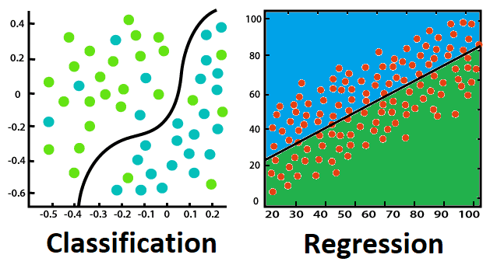
Regression Definition
The class of ML problems concerned with predicting a continuous value given an input
Examples:
Given the weather today, predict the weather tomorrow
Given the population today, predict the population in 2 years
Given the current value of a stock, predict its value in 1 year
Given your current height, predict your height in 3 years

Slide 26
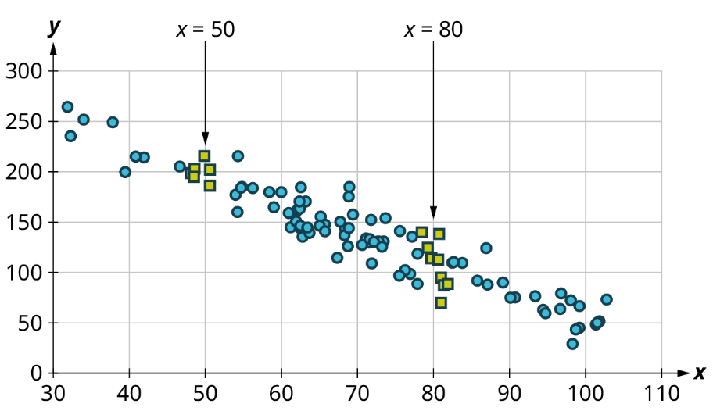
Q: You have some data points, how would you go about making a regression model for it? Think about the data below:

Slide 27
A: Simple, draw a line that captures the correlation!
This straight-line solution is called a linear regression

Slide 28
Today we will cover simple regression techniques–basically different shaped lines to fit different kinds of data

Slide 29
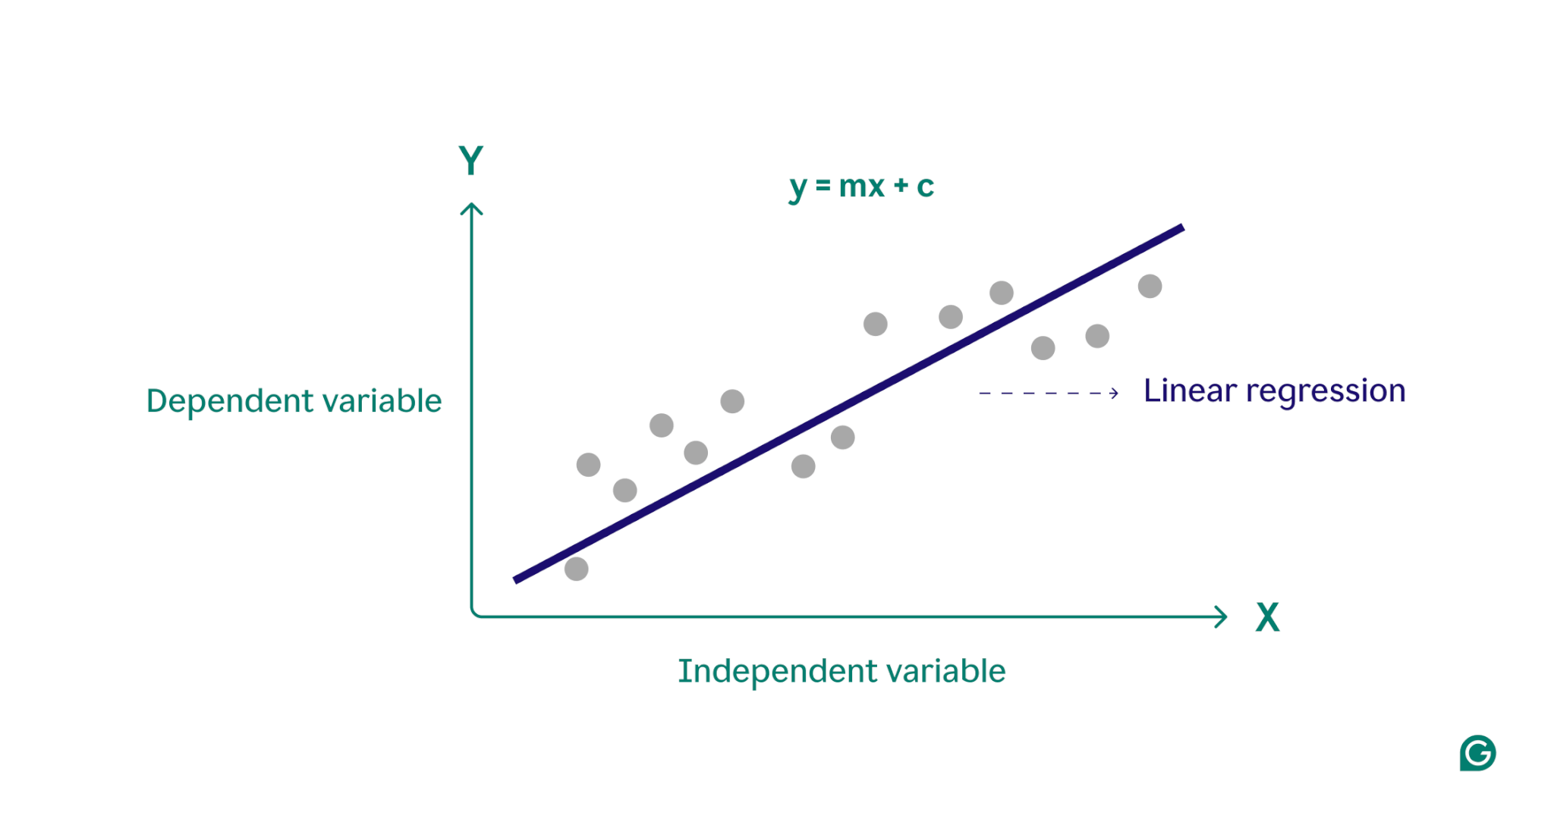
Linear Regression
Simplest kind of regression
Use a straight line that fits the data best

Slide 30
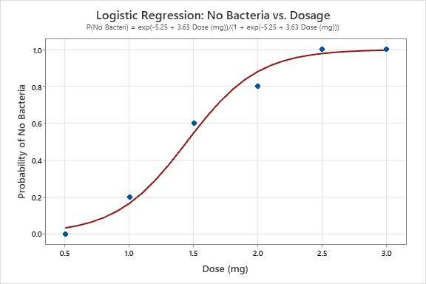
Logistic Regression
“S-shaped” curve
Often populations of animals follow this curve, as well as some other phenomena in nature

Slide 31
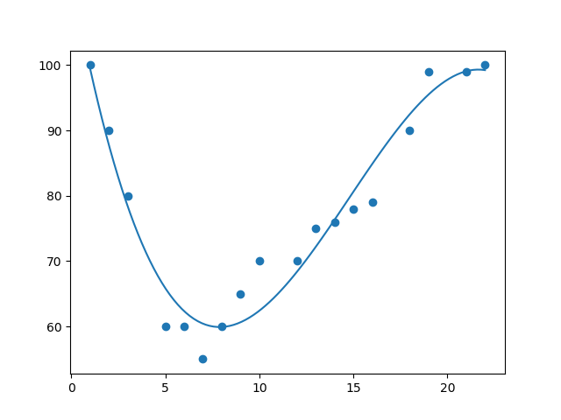
Polynomial Regression
Fit a polynomial (think more squigly) curve to the data
Many things in nature can be described by polynomial curves

Slide 32
Section III: LLM Tool Usage Notes

Slide 33
LLM Tool Usage
LLM tools include ChatGPT, Perplexity, Claude, and Cursor
Can be extremely useful!
We want you to use these throughout the class, as they can drastically improve your productivity
However, there are good ways to use these tools (improve learning ability), and there are bad ways to use them (learn nothing, do no work)
We will guide you through best practices and our expectations for this class!

Slide 34

LLM Tools Definition
An LLM tool is a tool that uses large language models (a kind of ML model) to understand natural language text for various tasks, including generating new text or code

Slide 35
(A few) LLM Tool Uses
All things code!
Writing code
Commenting code
Debugging code
Explaining things (especially given examples)
Explaining code
Explaining concepts
Explaining writing from someone else
Rewording or transforming existing text
Simplify text
“Explain text as if you are talking to a 3 year old”

Slide 36
Our Primary LLM Tool Uses
We want to use LLM tools for two things: Improving our learning, and improving our productivity
Improving Learning: Explaining things to us, giving us tutorials for how to do things
Improving Productivity: Spending less time looking up how to do things, less time figuring out how to fix broken things, and more time just doing things

Slide 37
Coding Process With vs. Without LLM Tools
Without:
Coding Problem
Read About How To Implement
Try writing code
Debug Code
Final Code
With:
Coding Problem
Try writing code
Debug Code
Final Code
Notes:
Main idea: coding with LLMs saves a lot of time looking up how to do things and implementing them wrong then having to do more research. You still might have to debug, but the process is generally a lot shorter and you don’t do the code-research-rewrite cycle repeatedly

Slide 38
LLM Tool Dos & Don’ts
Do:
Break down large problems into smaller problems, and have GPT solve the smaller problems
Generate code with GPT, but have it explain what all the code does
Make sure that you thoroughly understand how anything GPT produces works
Don’t:
Feed large problems to GPT and have it solve the whole thing then copy the solution
Generate and copy code without understanding it
Use GPT to write your essays or presentations (while good, it still does not sound human)
Notes:
Main idea: LLM Tools should not replace understanding, but instead augment it

Slide 39
Key takeaway: LLM tools are not a replacement for thinking → instead, they should help you do more thinking in less time, spending more time understanding high level concepts and less time figuring out small problems

Slide 40
Section IV: Regression Exercise

Slide 41
Regression Exercise Overview
3 Topic Options:
Sports dataset
Finance dataset
Sustainability dataset
We provide the dataset (code to download the dataset)
You will build a linear regression machine learning model for your dataset of choice
Allowed to use any tools you need to do this (ChatGPT, Google, etc.)
Will present your work/knowledge in the form of both a Google Doc & a slideshow

Slide 42
Regression Exercise Instructions
With your group, decide on which dataset you want to work with
Split up into 2 groups–coders (group members that know Python), and non-coders (students that do not know Python)
Coders: Code up the linear regression model!
Create a copy of the Google Colab with your dataset of interest
Download the dataset, familiarize yourself with its structure
Build your linear regression model using sci-kit learn
Make 2 graphs:
1 of the linear regression on the training data
1 of the linear regression on the testing data
Include mean squared error for both
Non-Coders: Present the ML model building work!
First, create a Google Doc, in it, write a paragraph about each of the following:
What is the problem that you are solving?
What is the data that you are working with (structure, where it is from, etc.)
What kind of model are you building? How are you training it?
How are you assessing how good your model is?

Slide 43
Regression Exercise Instructions Continued
4. Non-coders:
Then, present your work in the form of a slideshow presentation
Slideshow should address each of the same points as listed previously for your Google Doc
But here, minimize writing on your slides, and try to use more visuals/brief bullet points

Slide 44
Regression Exercise Instructions Continued
Deliverables by end of day:
Colab with a working linear regression model for your dataset + two plots, one of regression with training data, and one of regression with test data
Google Doc explaining what you did conceptually (problem, solution, model, data, results)
Slideshow presentation of knowledge from Google Doc (same content)

Slide 45
Please Find Gdrive For Exercises At The following link
https://tinyurl.com/2pryuuea
Regression Exercises → Templates
Select the template for the project that you want to do!
Sustainability: STUDENT_Regression_Sustainability_Exercise.ipynb
Sports: STUDENT_Regression_Sports_Exercise.ipynb
Finance: STUDENT_Regression_Finance_Exercise.ipynb
Make a copy of the Colab that you want to work with, and get to coding
When done, upload work!
Code: Regression Exercises → Code_Upload
Slides: Regression Exercises → Slides_Upload

